Slide 1
Blue Title Slide 1
Sub-title

Slide 2
Blue Title Slide 2
Sub Title

Slide 3
Picture Title Slide

Slide 4
Section Tile Slide

Slide 6
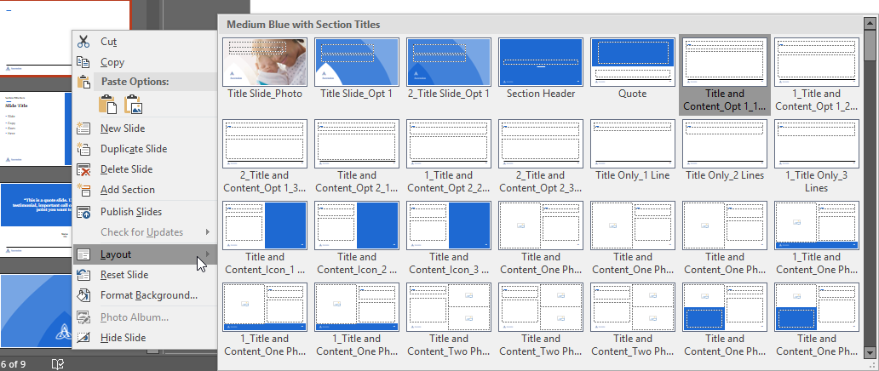
Want to Change the Slide Layout or Color?
Right Click a Slide in the Organizer Pane
Click “Layout” and then scroll through all the available layout options.

Slide 7
Slide Title
Section Title Here
Slide
Copy
Goes
Here

Slide 8
“This is a quote slide. Use this to share a testimonial, important call out, or some other copy point you want to focus on.”
Name
Title

